Slide 1
Custom program: Hospital Management System
Nguyen Duc Thang – Student ID: 104776473

Slide 2
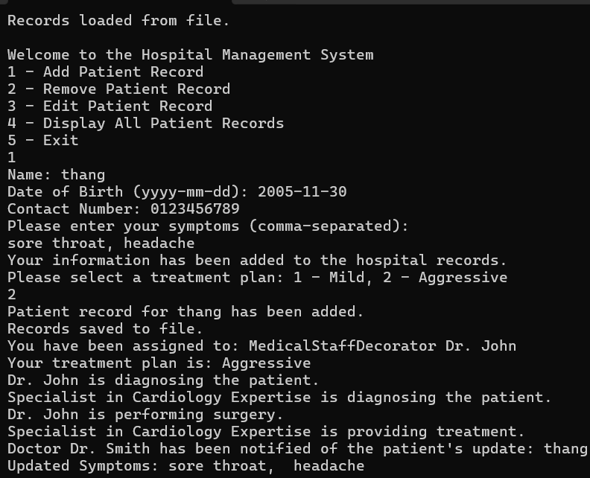
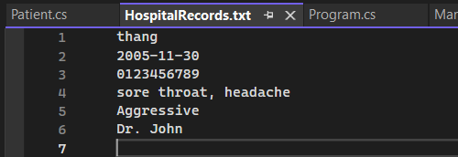
Functionality and Design Patterns
Functionality:
Give patients treatment plan and store in the file system
Edit the patient record
Design patterns:
Singleton
Factory
Observer
Strategy
Decorator

Slide 3
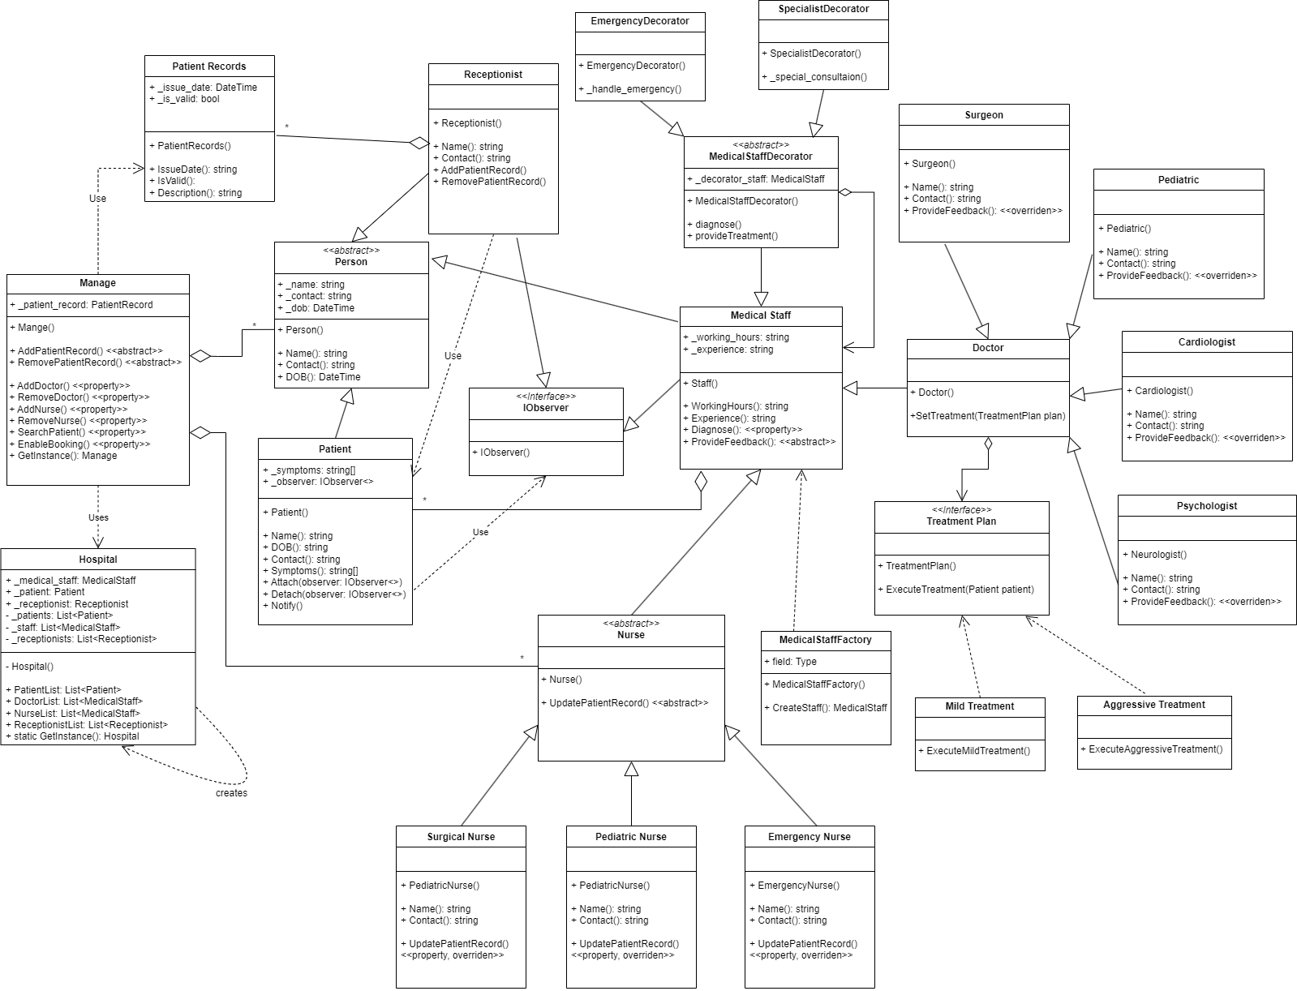
Program complexity
Programing
24 classes in total
Design patterns

